Slide 1
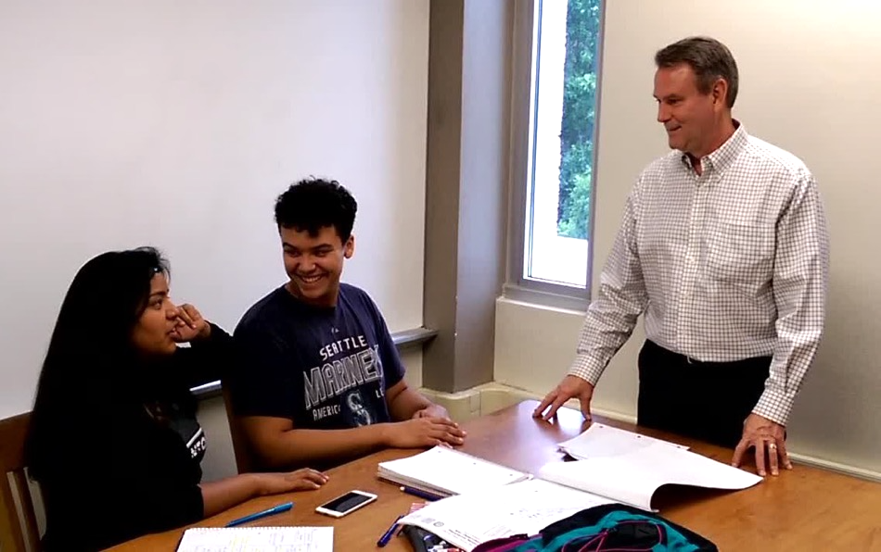
Follow your passion and you will have a rich and rewarding life. My passion is to design and build beautiful campuses, buildings, and spaces. But these are more than just buildings. They are where our future leaders are inspired, challenged, and molded to go make a difference in our world.
—Mitch Wilson, Alamo Colleges (Texas)

Slide 2
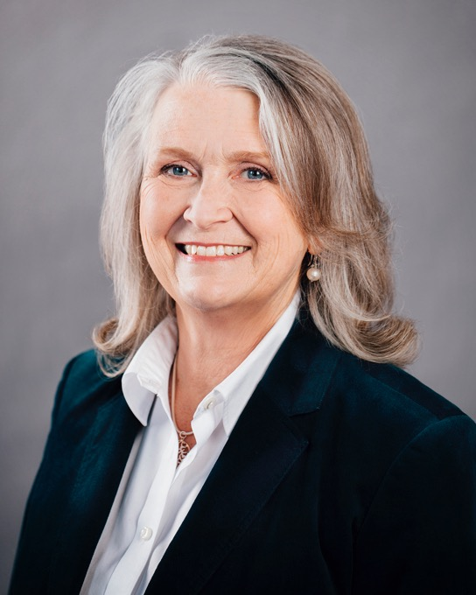
I have the privilege to work in an environment with faculty, staff, and students who challenge and inspire my approaches to learning and leadership. I have been afforded many opportunities in my career at Algonquin, and my goal has always been to give back as much as I receive.
—Lorna Brigden, Algonquin College (Ontario)

Slide 3
I can’t image a more fulfilling career than the one I have. I get to help shape the educational experience of our students and even sometimes have a hand in shaping their futures. This is something that I take to heart every day, and what drives me.
—Jodi Bucholtz, Algonquin College (Ontario)

Slide 4
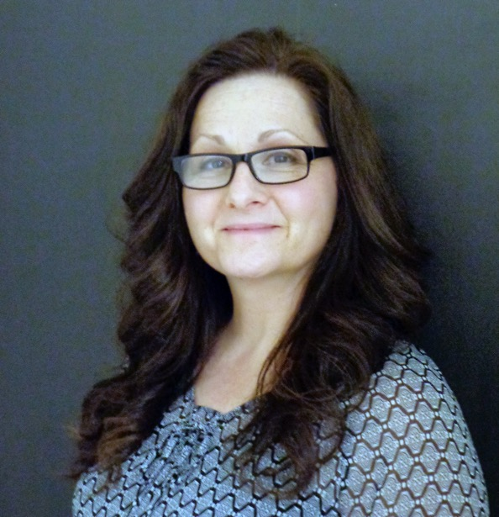
I take pride and satisfaction in giving my personal best. I look at each situation as an opportunity to see what value I can contribute to it. Most often, it involves simplifying; I enjoy reducing the “complicated” to find clarity. It is making the contribution that energizes me.
—Margaret Cayen, Algonquin College (Ontario)

Slide 5
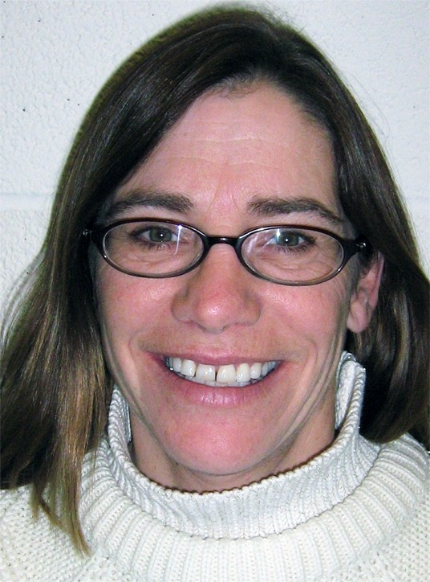
What excites me is equipment failure; to strive for excellence is inspired wholly by our students’ continued endeavors to advance during these times. Energy is sustained by my tight-knit group of mechanical and machinist gurus, and renewed daily at 11 a.m. by my oatmeal.
—Annie Langdon, Algonquin College (Ontario)

Slide 6
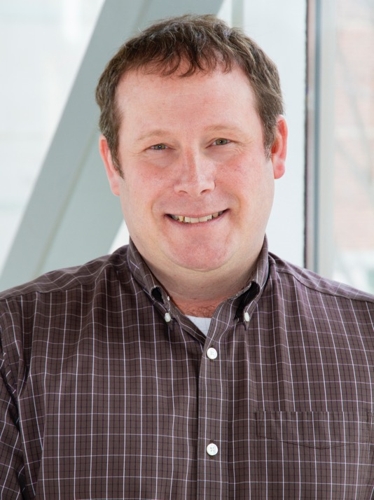
What inspires me? Our student base and the dedicated staff of Algonquin, who help make our students' dreams a reality.
I’ve been fortunate enough to work in many areas of the college and see firsthand the impact of how each and every interaction helps create a positive student experience.
—Robert Powell, Algonquin College (Ontario)

Slide 7
The first time I stood before a classroom of college students I knew I was in my element. I love their energy, spirited discussions, and the exquisite moments of enlightenment from unexpected places. I am grateful to be a part of my students’ lives and share in their learning.
—Jill Reeves, Algonquin College (Ontario)

Slide 8
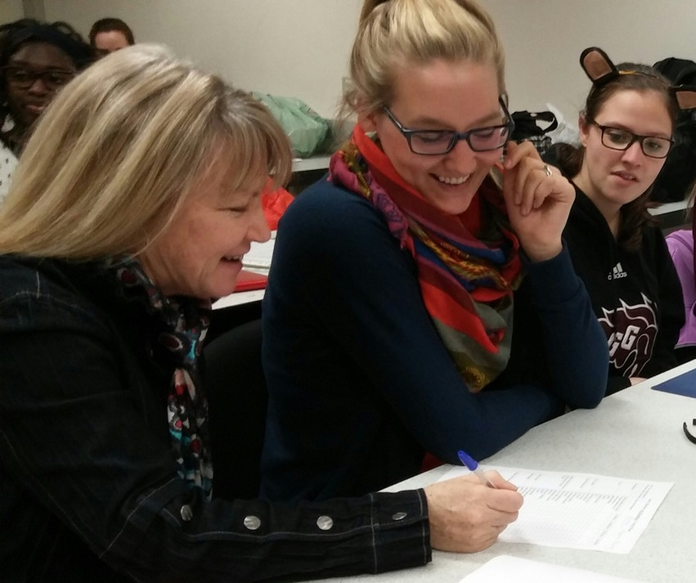
People thrive with hope, respect, and the desire to do their best and encourage others. I am inspired by students believing in themselves, making sacrifices to progress, and growing in pride and ability. With a supportive community of learners, teachers, and management believing in our potential, we all reach higher.
—Janet Scharfe, Algonquin College (Ontario)

Slide 9
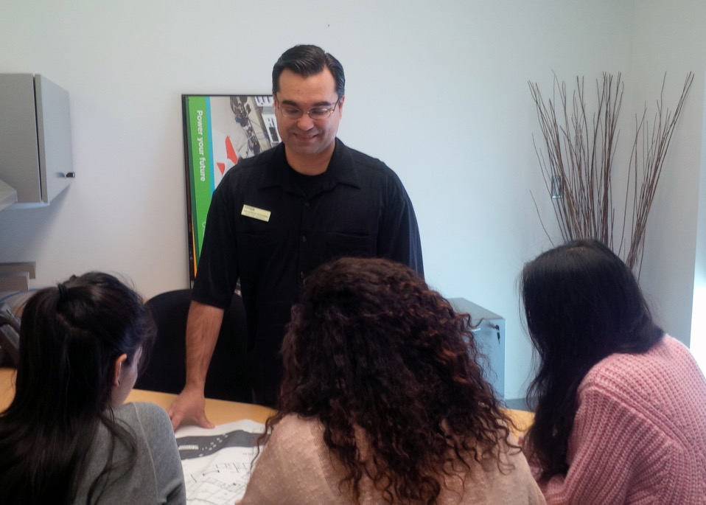
I find it very rewarding when I get to witness that “Aha!” moment in my students. When that lightbulb comes on, it makes me incredibly happy. It is the reason I do this every day.
—Francesco Tangorra, Algonquin College (Ontario)

Slide 10
My goal is to ignite passion or spark interest in one or more students in my classroom. I have a high standard for myself and the students I teach. I love what I do and I do what I love, and that is to cook and inspire others.
—Cynthia Toffanello, Algonquin College (Ontario)

Slide 11
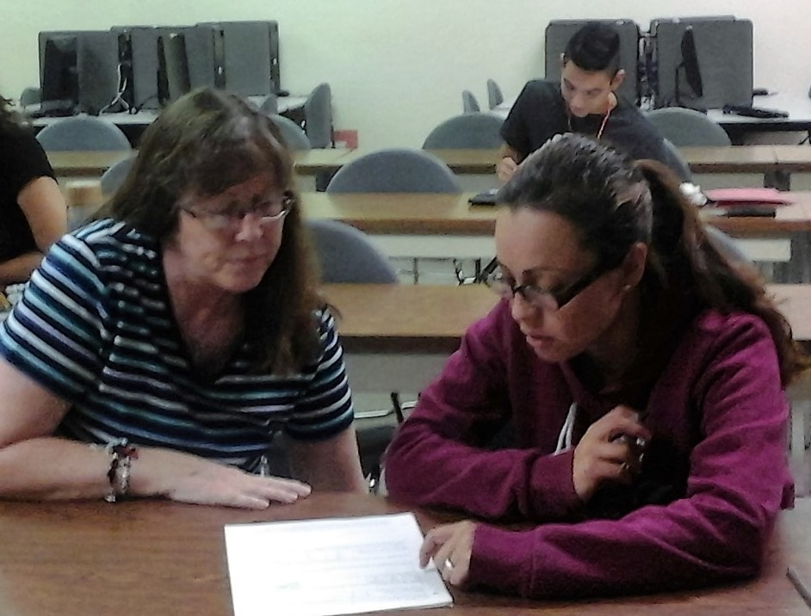
I teach statistics and calculus, which petrify students. It’s thrilling when I can remove the fear by breaking down the material to the point of maximum understanding. I use repetition, which is usually boring, but I somehow continually find ways to make it fun and interesting.
—Rita Brown, Arizona Western College (Arizona)

Slide 12
Students allow us to practice our trade—teaching. There is no book or code that tells us how to reach each and every student, but we must never stop trying. Prize-winning student or problem student, it does not matter, as long as we inspire them all.
—Pasquale Lamaestra, Arizona Western College (Arizona)

Slide 13
I encourage my language students to be prescriptively competent, yet descriptively curious. I teach students to learn through discovery, to learn to “fish” instead of waiting for me to feed them. We use non-contrived, real language to explore and express.
—Earl Smith, Arizona Western College (Arizona)

Slide 14
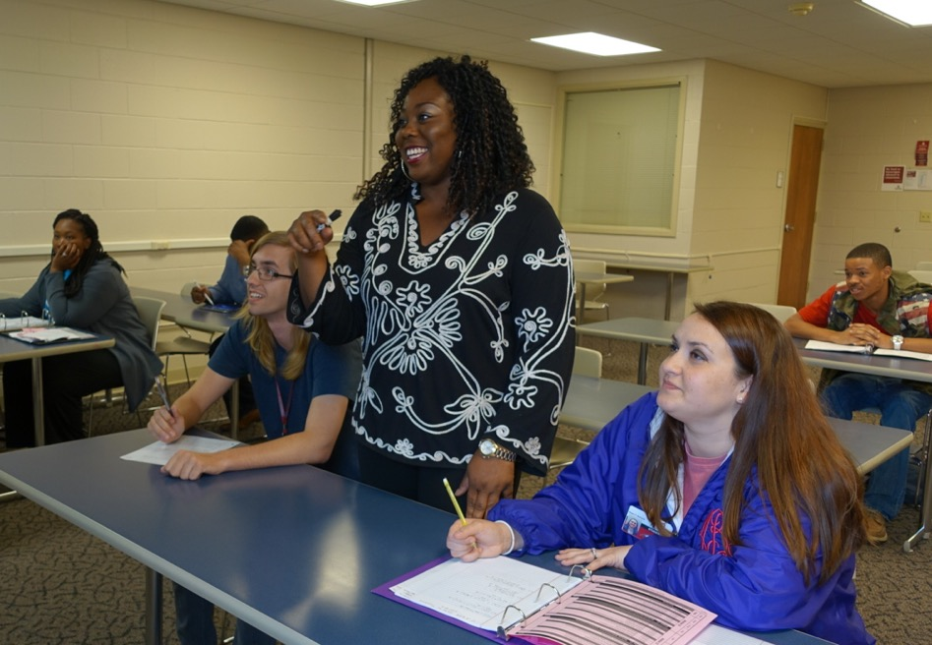
What motivates me most is changing a student’s perspective, whether improving his/her attitude towards learning math or encouraging lifelong learning. Student success is my ultimate goal. I make a concerted effort to know my students. I create supportive learning environments, give immediate feedback, promote cooperative learning, and provide data-driven assessments.
—Shermel Brown, Arkansas State University Mid-South (Arkansas)

Slide 15
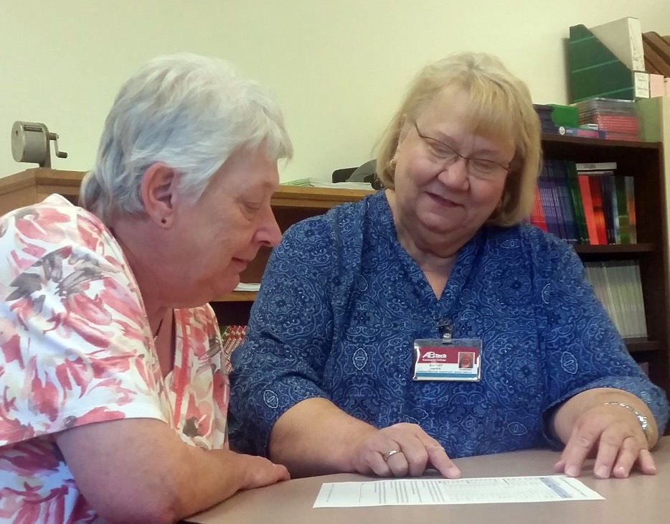
I found my thrill, and it is working with students seeking their High School Equivalency. Whether as an instructor or an advisor, I count it all as joy to see the students blossom as they realize their goal and find success. It is a life-changing experience for our students.
—Kathy Hipps, Asheville-Buncombe Technical Community College (North Carolina)

Slide 16
I incorporate the “The Hero's Journey” in my technology classes. The two conflicts in this narrative are the student versus the material, and the student versus their flaws. The boon received is service to others via the acquired skills. I seek to find the hero in all of my students.
—Kurt Nalty, Austin Community College (Texas)

Slide 17
Teaching is the best service I can do to make a difference in the lives of my students. When I pass the baton of knowledge to my students, I know I have also passed on to them the ability to imagine, dream, create, and excel in anything they want to be.
—Amrita Madabushi, Baltimore City Community College (Maryland)

Slide 18
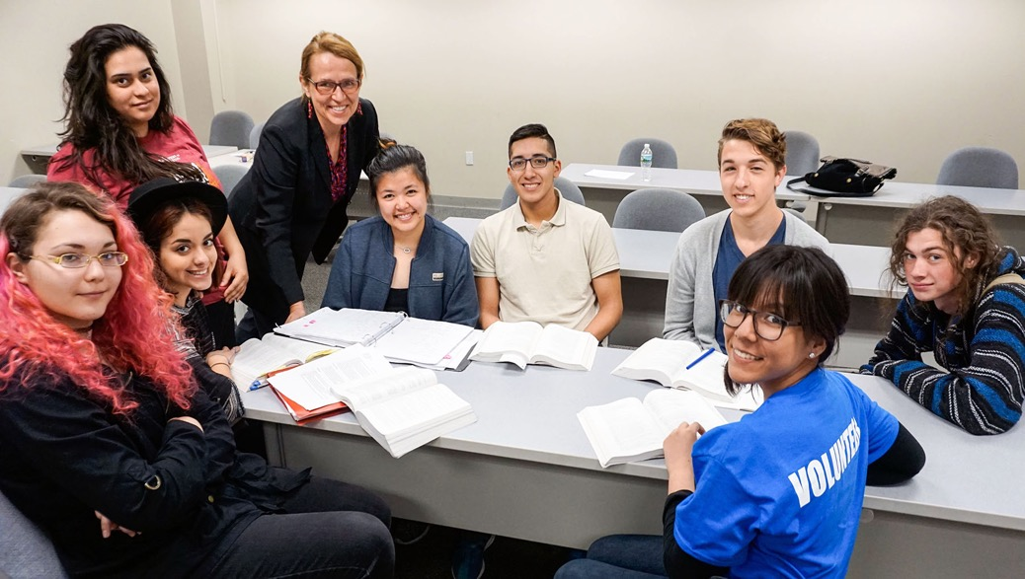
“Professor Makowiecka has consistently provided leadership for student success for the past 16 years—including her stewardship of the Dr. JKW School of Honors,” said Bergen Vice President of Academic Affairs, William Mullaney. “This award recognizes her continued contributions to the college as a scholar and mentor.”
—Maria Hanna Makowiecka, Bergen Community College (New Jersey)

Slide 19
Mathematics students are often afraid to try working problems for fear of making a mistake. I tell them making mistakes is how we learn. A mistake is not a failure, it is a first draft, a stop on the road to success. A mistake is progress toward the solution.
—Sally Olson, Blinn College (Texas)

Slide 20
—Edith Pequeno, Blinn College (Texas)

Slide 21
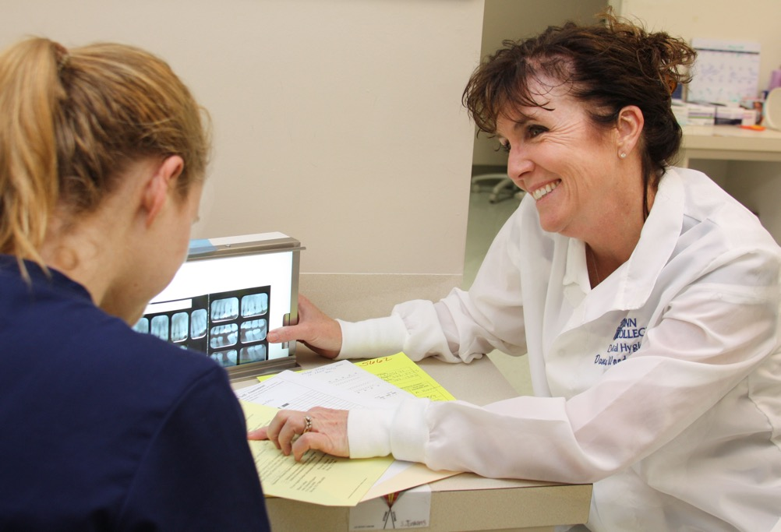
My teaching success is guiding students to strive for clinical excellence and to also be passionate about service to their communities. I encourage students to cherish relationships with patients and groups they reach out to help while passing the love and value of service on to future generations through their example.
—Dana Wood, Blinn College (Texas)

Slide 22
I am happy to join the global campaign to create open educational resources where my students can access my videos on YouTube for free, making education accessible and affordable. “Mathematics With Dan Avedikian” provides video solutions for every homework question. Students have access to the teacher 24/7.
—Dan Avedikian, Bristol Community College (Massachusetts)

Slide 23
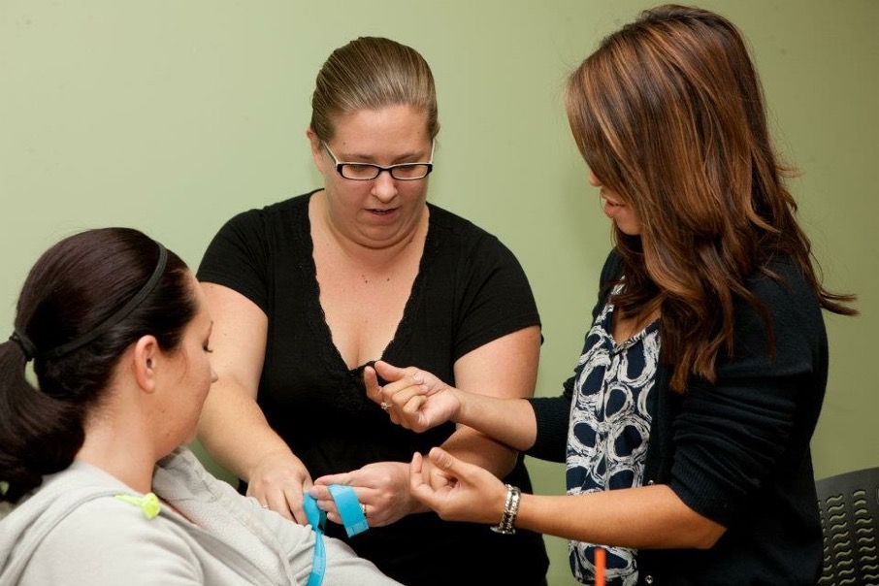
I had wonderful professors in college who had such enthusiasm and excitement that I couldn’t help but be excited, too. I asked myself, as an educator would I assimilate my favorite professors and garner the excitement of my students? Yes! Creativity, enthusiasm, and engagement encourage everyone. Who will you inspire?
—Kelli Hiller, Bristol Community College (Massachusetts)

Slide 24
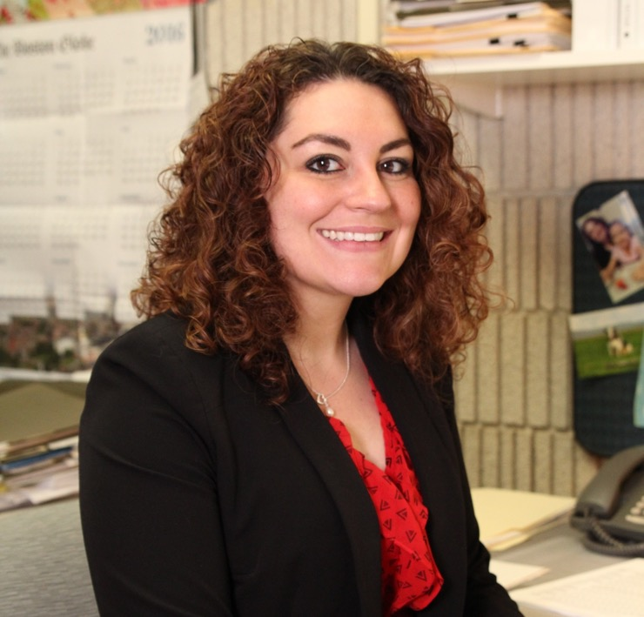
Brené Brown said, “Maybe stories are just data with a soul.” I live by this saying as I collect and analyze data—trying to find the story behind it all. I'm inspired by being able to look beyond the numbers, making meaning of information to strengthen the college.
—Angelina O'Brien, Bristol Community College (Massachusetts)

Slide 25
I have two absolute joys in my professional life: veterinary medicine and teaching veterinary technology students. I love seeing a student mastering a skill or concept that I have taught them. This is what makes my job a perfect fit in my life.
—William Lineberry, Cedar Valley College (Texas)

Slide 26
My motivation is to get every student to see themselves as whole and capable. Their learning encompasses “doing” and “being.” “Doing” the content of the course and gaining skills to see and act on “being” the person they want to be.
—Lisa Spring, Central Piedmont Community College (North Carolina)

Slide 27
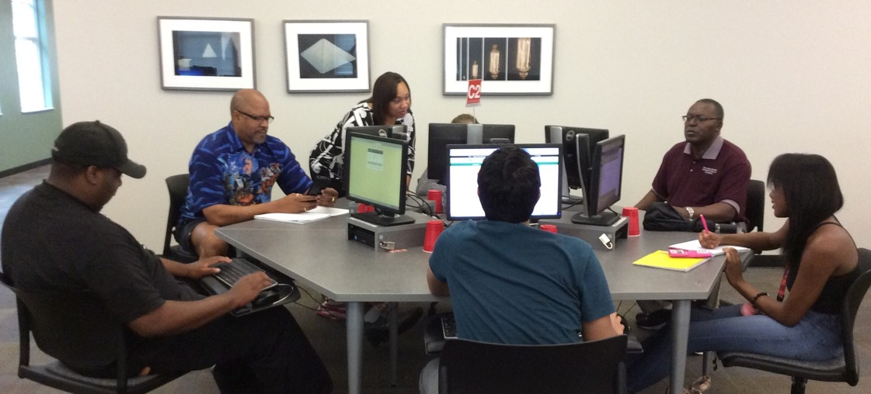
My passion for teaching originates from my own experiences with learning. I strive to maintain a compassionate learning environment so my students feel comfortable engaging in the learning experience. I help students make connections from the textbook to real-world applications so they see how math applies to their lives.
—Christie Williams, Central Piedmont Community College (North Carolina)

Slide 28
Each student who walks through that classroom door is my child. Every student that I have contact with will be taught the way I want my child to be taught. Therefore, the students receive the very best of what I have to offer.
—Linda Rowland, Clarendon College (Texas)

Slide 29
As an engineering instructor my primary focus is to prepare students to be future engineers, and worthy of being hired by engineering organizations. I give my students a heavy dose of reality when it comes to engineering, physics, and mathematics by asking them to also consider solving “real-world” problems.
—John Warren, College of Southern Maryland (Maryland)

Slide 30
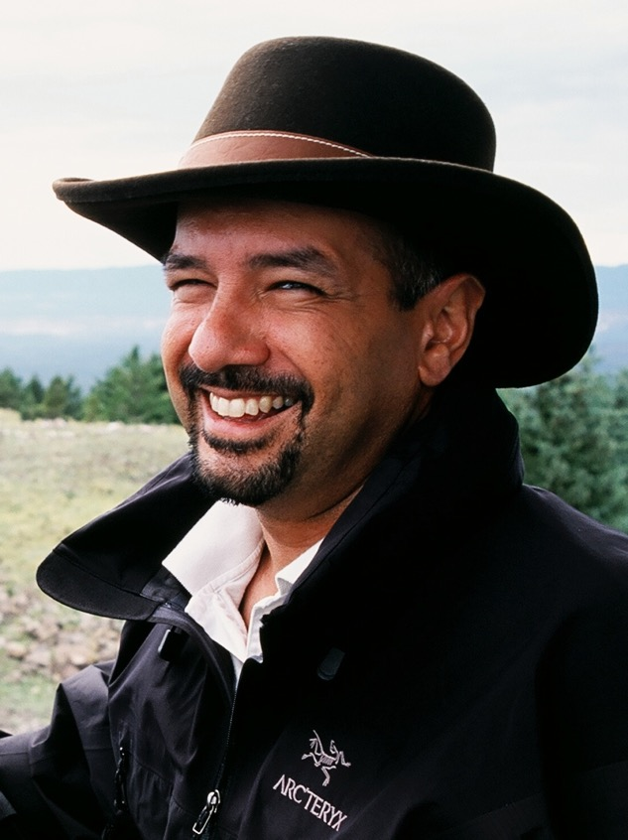
With filmmaking, the student must learn to trust his or her instincts, be both artist and craftsperson, be fearless and flexible, be a leader and able to listen, work hard, and never give up. The end result is not the film itself, but the measure of the person who created it.
—John Aliano, College of Southern Nevada (Nevada)

Slide 31
I teach because I get to witness remarkable transformations in my students. I see students who start out not knowing what DNA is transition into individuals producing cogent arguments about their views on stem cell research. I also get the opportunity to positively influence students’ attitudes about science.
—Deborah Cardenas, Collin College (Texas)

Slide 32
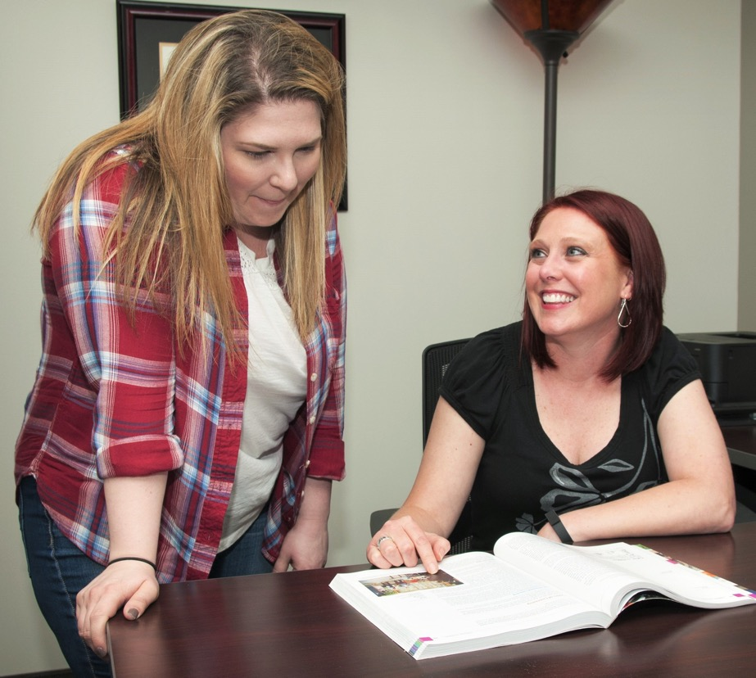
True competence is achieved through the process of putting a puzzle together so that you first understand the details of all the pieces, then recognize the big picture created by the interaction of all the pieces, and finally, appreciate how that big picture influences and applies to other contexts.
—Amy Greene, Collin College (Texas)

Slide 33
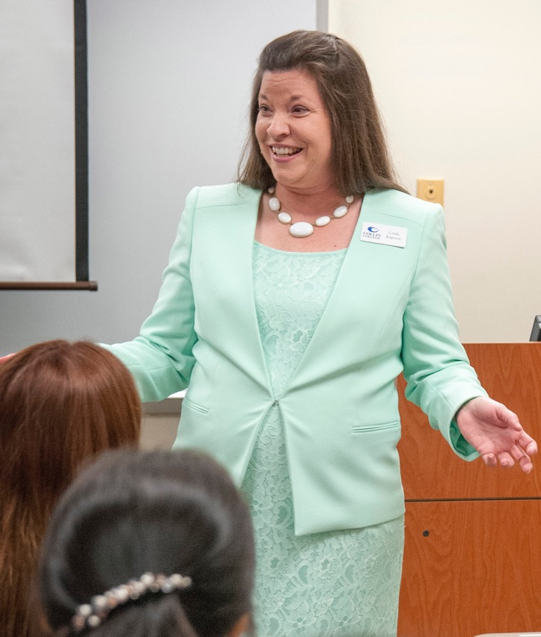
Teaching ESL students who have brought their hopes, talents, and visions to the U.S. and to my classroom continually inspires me. My work with extraordinary students and colleagues at Collin College is such a blessing and brings a smile to my face every day!
—Linda Kapocsi, Collin College (Texas)

Slide 34
“I appreciate the NISOD award and recognition, and am humbled to be included with such an esteemed group of colleagues. When you love what you do, it hardly feels like work!”
—Karen Musa, Collin College (Texas)

Slide 35
“Imagination is the only thing in life that will limit you; don’t let life limit your imagination.” Every time I walk into my classes I am amazed by the level of knowledge of our workforce individuals.
—Andrea Szlachtowski, Collin College (Texas)

Slide 36
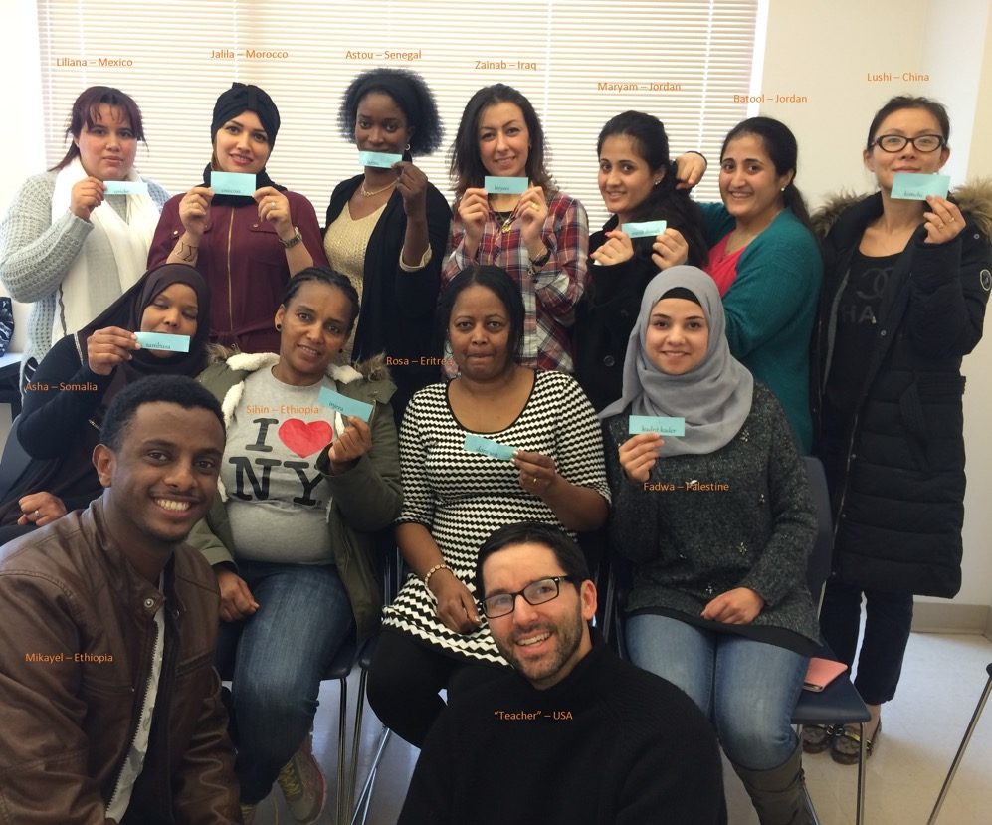
I tell my ethics students that they are “some of the lucky few who, for approximately three hours a week, will ponder and discuss what literally constitutes 'the good life.'” Indeed, I feel even luckier to be the one who facilitates the process!
—Rick Miller, Columbus State Community College (Ohio)

Slide 37
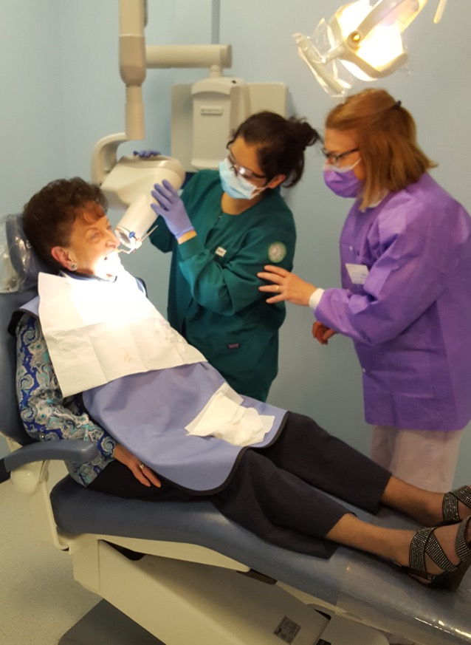
In today's world it can be a challenge to engage students with direct “in-person” guidance. While I participate in many forms of teaching, I take pleasure in hands-on interaction. In the health field, nothing replaces human experience with professional guidance through the rough parts.
—Melissa Sullivan, Community College of Rhode Island (Rhode Island)

Slide 38
Our faculty members are guided by the adage, “The best things in life are free.” Voluntarily, we developed a college-prep textbook and a repository of more than 200 math videos offered free to students. We also believe we should meet the students where they are, not where we want them to be.
—Marc Campbell, Daytona State College (Florida)

Slide 39
I tell my students every year, writing is a process of thinking, and thinking varies from person to person. We’re different people; therefore, we think differently and write differently. This is one challenge we face.
—Sarah Inman, Delgado Community College (Louisiana)

Slide 40
As a teacher I strive to engage, challenge, and inspire growth in my students. It is my belief that every student is capable of experiencing the passion that I feel for the biological sciences by becoming collaborators in the exploration of theory, content, and practice.
—Amanda Rossenzweig, Delgado Community College (Louisiana)

Slide 41
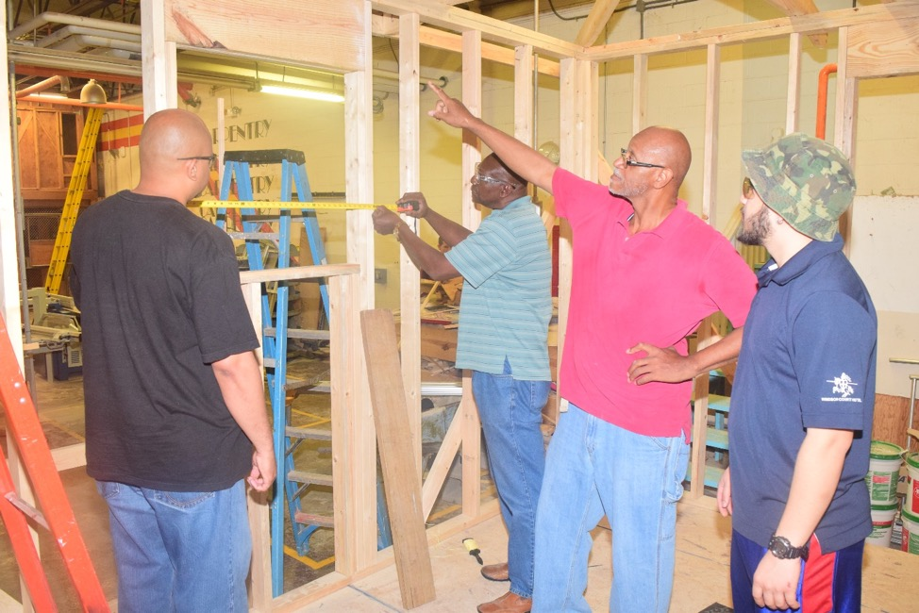
Please teach me. I am your student who is no longer willing to repudiate learning. No longer willing to be blurred by my own dimmed light, I am ready to view the impossible as doable, ready to see difficult as unfamiliar. Please teach me. I’m ready.
—Kenneth Williams, Delgado Community College (Louisiana)

Slide 42
Teaching is an opportunity to make a difference, to touch the future. Good teachers are immortal; their curiosity, their love of learning, and their commitment to make the world a better place go on to influence generations of students. I aspire to be one of those teachers.
—Benja Allen, El Centro College (Texas)

Slide 43
All students cannot learn all things, but they all can learn something. When reflecting on why I became a teacher, I keep this in mind. Teaching is challenging, but rewarding in knowing that I am in a position to encourage and to promote the desire for lifelong learning in students.
—Michelle Conklin, El Paso Community College (Texas)

Slide 44
My inspiration in life is caring, dedication, and making a difference in people's lives. I always knew I wanted to become a nurse and when I realized that I loved teaching, I decided to do both. Teaching combines two of my passions: caring for others and making a difference.
—Virginia Madrid, El Paso Community College (Texas)

Slide 45
As the first in my family to earn a doctorate, I place an elevated importance on education. As a scientist I consider teaching not only a duty, but also a privilege and pleasure. My goal is to ignite a passion for science while mentoring students to continue their education.
—Jose Pacheco-Lucero, El Paso Community College (Texas)

Slide 46
How to leave a piece of your soul in your classroom:
Understand each student’s culture, background, and interests.
Be an engaging actor, producer, and entertainer.
Have students apply what they learn.
Recognize students’ work and be an example to follow.
Repeat for every class.
—Christian Servin, El Paso Community College (Texas)

Slide 47
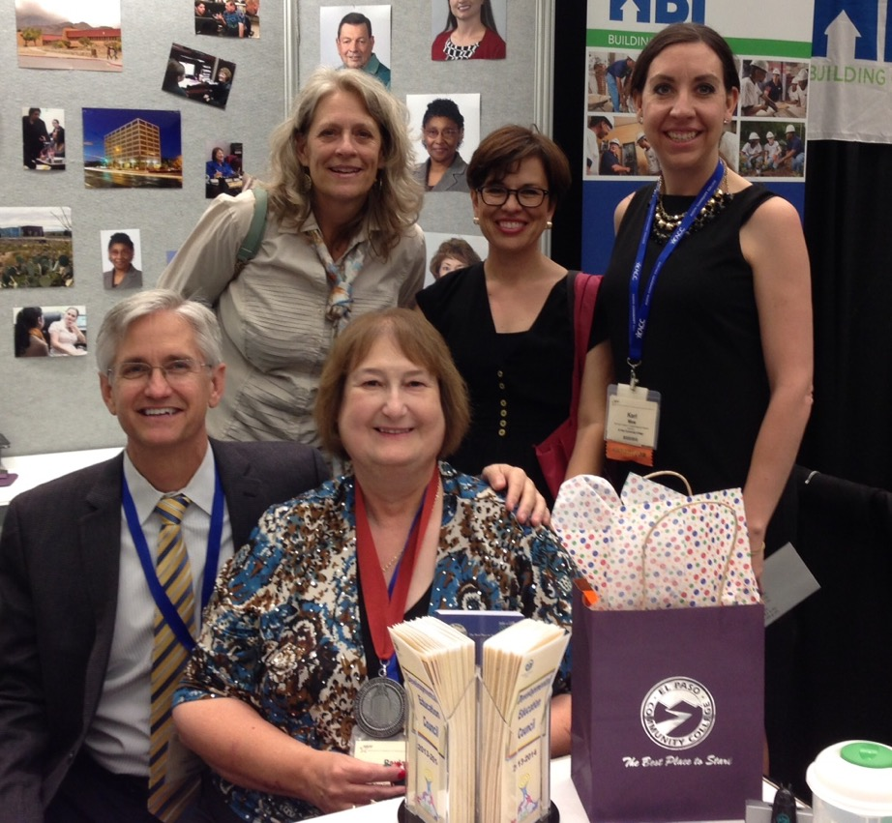
The work we do every day at El Paso Community College can change families' lives for generations to come. I am inspired by the innovative strategies faculty and staff develop to support our students in meeting their educational goals and advancing their careers.
—Steve Smith, El Paso Community College (Texas)

Slide 48
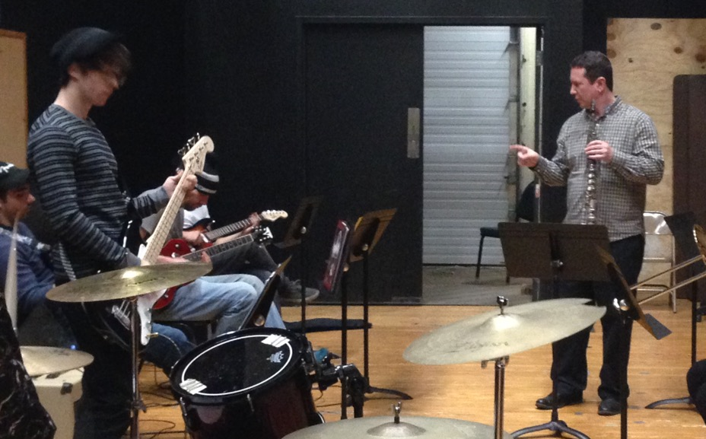
Giving students an opportunity to experience things they would not normally get a chance to experience inspires and motivates my teaching. I bring real-life experience into the classroom and even have students sit in with my band. The looks on their faces after playing with a professional band are priceless.
—James Runfola, Erie Community College - North Campus (New York)

Slide 49
All students, no matter what level, have strengths and bring them to the classroom. My objective is to find and acknowledge those strengths and give students the confidence to succeed in and outside the classroom. They teach me as I teach them.
—Anastasia Amabisca, Estrella Mountain Community College (Arizona)

Slide 50
As an early childhood education professor, I work with students who will educate our future. A person learns more in the first five years than during any other five-year period of time throughout the rest of his or her life. My passion is to give teachers the tools needed for success.
—Sharron Cuthbertson, Florida Gateway College (Florida)

Slide 51
Learning a language is far more than learning vocabulary and grammar. It’s learning to critically consider your own worldview and that of others. It’s the willingness to seek out and embrace that which is different from you and to incorporate that learned understanding into your own value system.
—Kyle Kendall, Gateway Technical College (Wisconsin)

Slide 52
Student success is my motivation. Designing activities that engage students in the learning process is my passion. All students should be given the opportunity to experience creative and interactive learning environments in every field of academia.
—Craig Schambow, Gateway Technical College (Wisconsin)

Slide 53
Every student comes to us with unique life and educational experiences. I strive to meet them where they are and work to get them where they want to be. Helping students reach those goals is my passion and motivation. I believe in empowering each student to realize their dream.
—Susanne Stokes-Nelson, Gateway Technical College (Wisconsin)

Slide 54
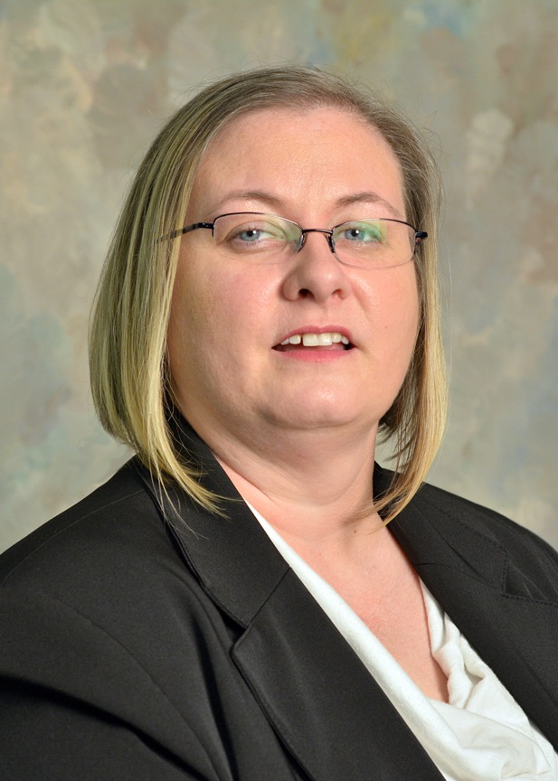
I was taught at a young age that you get what you give, so try your best at everything you do. You’re not always going to be right, but try to do the right thing and keep your head up. Be proud of your work and how you treat people.
—Stacey Harris, Georgia Piedmont Technical College (Georgia)

Slide 55
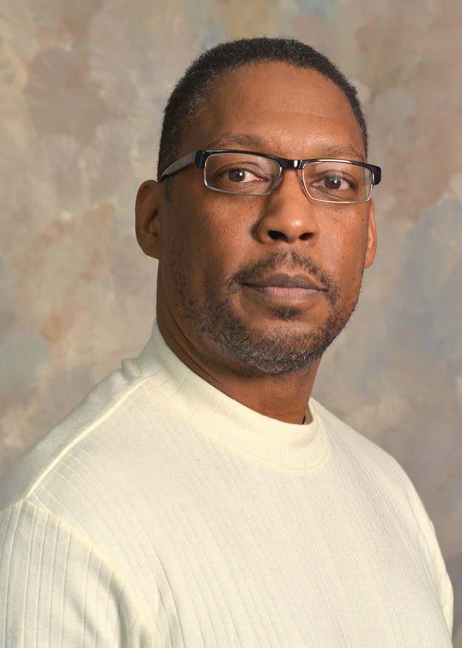
As a teacher and mentor, I feel the greatest attribute to exhibit is that of a servant. I also believe that character has an important role in impacting lives, and will be tested with how one responds to adversity. Anyone can be nice, but not everyone can respond to affliction.
—Willie Harvey, Georgia Piedmont Technical College (Georgia)

Slide 56
As an early childhood educator, I find that reawakening our inner child’s natural art of inquiry and investigation has been my inspiration for guiding and facilitating adult learners.
—Judy Gonzales Poggi, Glendale Community College (Arizona)

Slide 57
Most of my courses deal with students' confidence in their own abilities, so I continually focus on ways to help them relax, have fun, and see their own personal growth. I work to build relationships that are strong enough to support taking risks while practicing new concepts.
—Lori Walk, Glendale Community College (Arizona)

Slide 58
When we encourage learning but expect perfection, we miss opportunities for novelty and create barriers that are difficult to overcome. By encouraging students to extend themselves beyond their comfort zones, and then urging them to embrace inaccuracies with enthusiasm instead of anxiety, we introduce them to the love of learning.
—Sherry Massoni, Harford Community College (Maryland)

Slide 59
I believe in the student-teacher relationship. I encourage students to challenge themselves, so I work hard to support their understandings of the process and product. It is inspiring when their tenacity leads to success and when they use their newfound knowledge and abilities in whatever way is meaningful to them!
—Elizabeth Mosser, Harford Community College (Maryland)

Slide 60
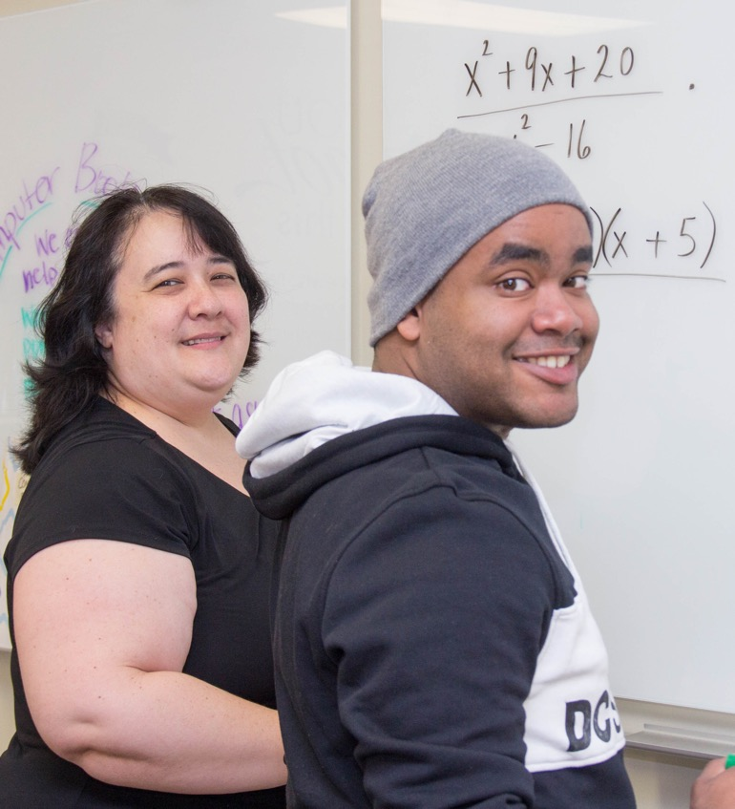
My inspiration and motivation are fueled by students’ journeys. I strive to meet their academic needs and to reward courage with encouragement. As a developmental mathematics educator, daily I experience the joy of witnessing students fight through the tears and frustration to achieve smiles and confidence. Best . . . job . . . ever!
—Elizabeth Dunn, Harrisburg Area Community College (Pennsylvania)

Slide 61
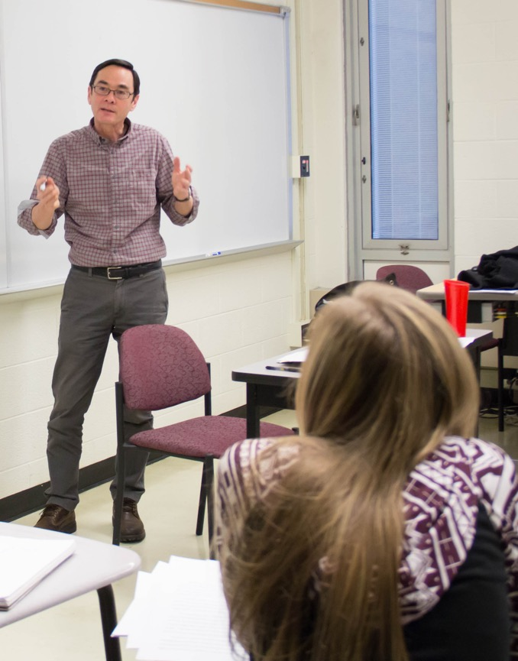
Be direct, but not categorical. Imagine form and process—rather than function and product—as your ultimate aims. (How different becomes the world!) Kindness and appreciation are wonders. Their expression is always life affirming. Don’t retreat from dwelling with mystery.
—David Liu, Harrisburg Area Community College (Pennsylvania)

Slide 62
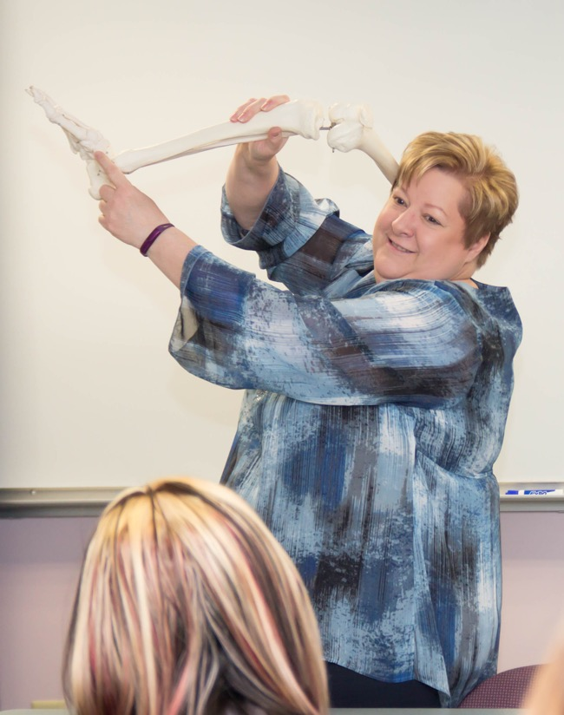
The greatest achievement I could ever hope to accomplish is to help people achieve their dreams, realize their hopes, and reach their potential. It inspires me to teach from a student-focused heart that does whatever it takes to provide each student with the skills and knowledge needed for their life’s journeys.
—Rebecca Shoener, Harrisburg Area Community College (Pennsylvania)

Slide 63
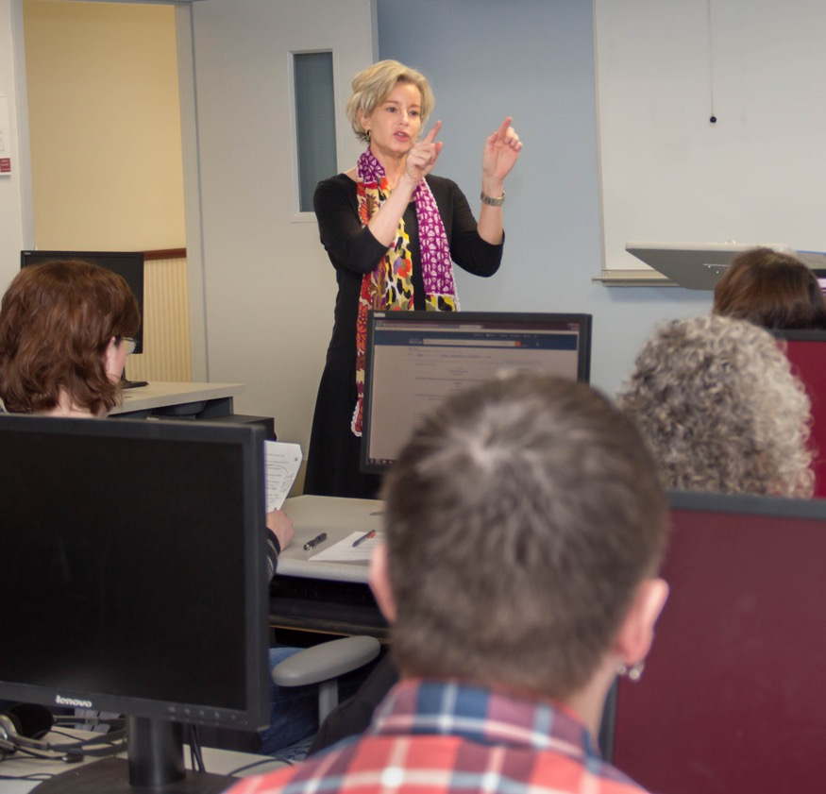
My students teach me kindness. Some students think learning about law will be so difficult! I remind them that they already know so much about it. It’s best to point out each one’s progress, encourage each small effort. The carrot works much better than the stick for all of us.
—Lisa Wolf, Harrisburg Area Community College (Pennsylvania)

Slide 64
Teaching psychology is a challenge. On the one hand, the topics are closely related to every student's life. On the other hand, psychology is a science and conclusions must be based on valid research. I enjoy finding examples that are able to combine those.
—David Gersh, Houston Community College (Texas)

Slide 65
Remember, education begins at birth. It ends at death. So keep your head up. Read, teach, study, do, and learn all you can while you can. Technology is constantly changing. Believe in yourself, listen to experienced mentors in your field, help others, and love success.
—Rita Punch-Lagard, Houston Community College (Texas)

Slide 66
I enjoy teaching and giving back to the community. Students inspire me, and giving them the opportunity to learn is rewarding. Socrates once said, “I cannot teach anybody anything; I can only make them think.”
—Armando R. Villanueva, Houston Community College (Texas)

Slide 67
Learning is proactive. I remind my students that we as individuals have a responsibility in our own learning. I wish I could teach them everything. I try my best to make learning fun so students will apply clinical reasoning and critical-thinking skills. After all, we are saving lives!
—Lakisha Williams-Hadley, Houston Community College (Texas)

Slide 68
Endeavor to be inclusive, genuine, knowledgeable, and reassuring. Impart personalized knowledge to your students. When you see the gleam in their eyes or the subtle leaning forward to engage in the collective course room language, you have them.
—E. Anthony White, Illinois Central College (Illinois)

Slide 69
Students inspire teachers to find new ways to teach the knowledge and professional values that are paramount in their future practice.
I have tried to see all the possibilities in each student. I have come to love my role as an educator. It is wonderful to share the journey.
—Carol Amole, Indian River State College (Florida)

Slide 70
Even after many years in the field, I cannot imagine another career I would have enjoyed as much as I have being a counselor. No two days are alike; no two students are alike; no two sessions are alike. If variety is the spice of life, I am well-seasoned.
—Lill Bajich-Bock, Johnson County Community College (Kansas)

Slide 71
Teaching is a ripple effect, a focused act that has the power to change lives.
—Cynthia Feagan, Johnson County Community College (Kansas)

Slide 72
Socrates said, “Education is the kindling of a flame, not the filling of a vessel.” As educators, we are privileged to have the opportunity to invest in the next generation, inspiring and providing support to make dreams come true, despite the obstacles. It's our honor to feed the flame.
—Tena Cobb, Lamar Institute of Technology (Texas)

Slide 73
Dustin Hoffman once said, “Life is an occasion. Rise to it.” We are all presented with opportunities and moments to rise to the challenges of life. It is my privilege and my honor to help students rise to their full potential.
—Stephen Hudnall, Lamar Institute of Technology (Texas)

Slide 74
“Do or don't, there's nothing in between.” So believe in yourself and be true to yourself.
—Nicole Mitchell, Lamar Institute of Technology (Texas)

Slide 75
The strongest teachers watch and listen. We need to discover where each student’s strengths lie so we can build a path to success. We find them where they are and guide them to where they need to be.
—Tracy Spencer, Lamar Institute of Technology (Texas)

Slide 76
It has been a privilege to teach in the kinesiology field for 17 years at Laredo Community College. Having the opportunity to teach at the freshman and sophomore levels enables me to prepare, mold, and provide insight to students for their upper-level classes.
—Randolph Gonzalez, Laredo Community College (Texas)

Slide 77
The law enforcement profession inspired me to research, teach, and contribute to its advancement. Life’s tumultuous path led me to education and an instructional gateway of unlimited opportunities. Success in my personal and professional lives came from dedication (God, family), determination (never give up/fortitude), and discipline.
—Donald R. Hale, Laredo Community College (Texas)

Slide 78
My role as an educator is to instill in my students the motivation to learn on their own. I want them to question, reflect, create, discover, and be on the journey towards citizenship and self-transformation. My challenge is to inspire, respect, and honor each student’s unlimited potential.
—Horacio Salinas, Laredo Community College (Texas)

Slide 79
I'm truly honored to receive this award and feel strongly that the students, faculty, and staff of Lee College have been integral to my success. I aim to help our students in the best way possible and work diligently to develop processes that serve the campus and our community.
—Melissa Valencia, Lee College (Texas)

Slide 80
I am a product of TRIO SSS and I see the possibilities when serving a student. I respect their journeys and know each student is worth more than his or her worst action and is more than the worst thing done to them. I believe I am a vehicle for great change.
—Vera Walker, Lee College (Texas)

Slide 81
—Lana Myers, Lone Star College - Montgomery (Texas)

Slide 82
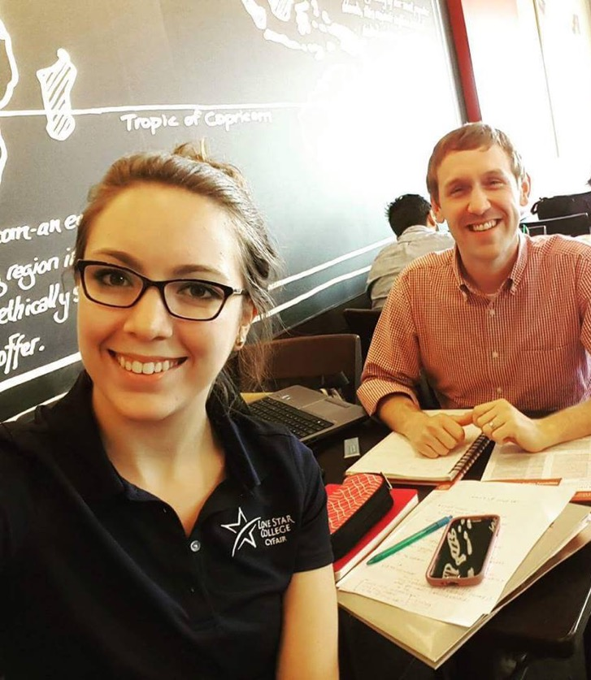
I embrace the goal of encouraging my students’ intellectual creativity, refining their skills as critical thinkers, and promoting a lifetime of learning. At the end of the day, I have a very simple goal: to teach my students at least as much as they teach me every day.
—Blake Ellis, Lone Star College (Texas)

Slide 83
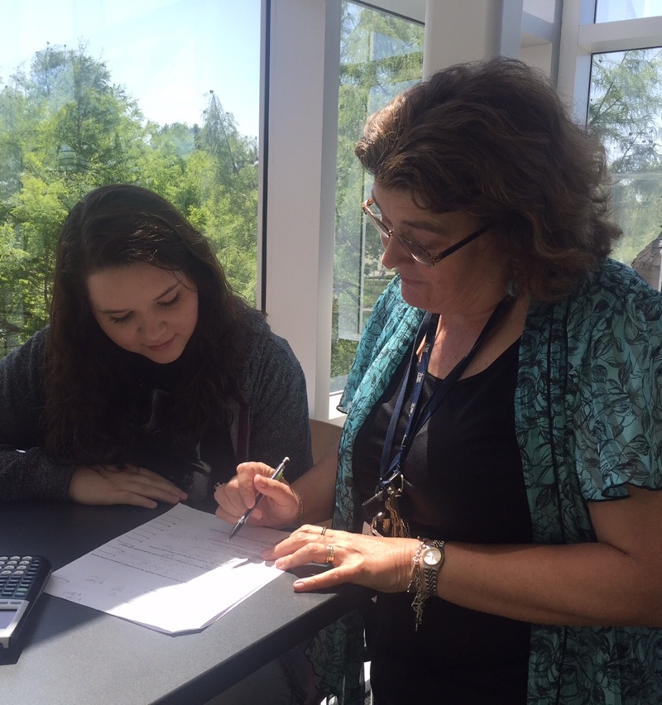
Helping my students achieve their goals, starting with a collaborative and upbeat atmosphere; lecturing with organization, enthusiasm, patience, encouragement, and activities; and explaining the concepts in the simplest terms possible using acronyms, catchy phrases, and sometimes singing, is what I do. My students know that “my door is always open.”
—Kimberly Lane, Lone Star College-Cy Fair (Texas)

Slide 84
“Beyond our ideas of right-doing and wrong-doing, there is a field. I’ll meet you there.” —Rumi. To help students move from what they think they know and reach for what they are capable of learning, I must let go of what I think I know and move toward what I am capable of teaching.
—Lisa Darling, Lone Star College-Kingwood (Texas)

Slide 85
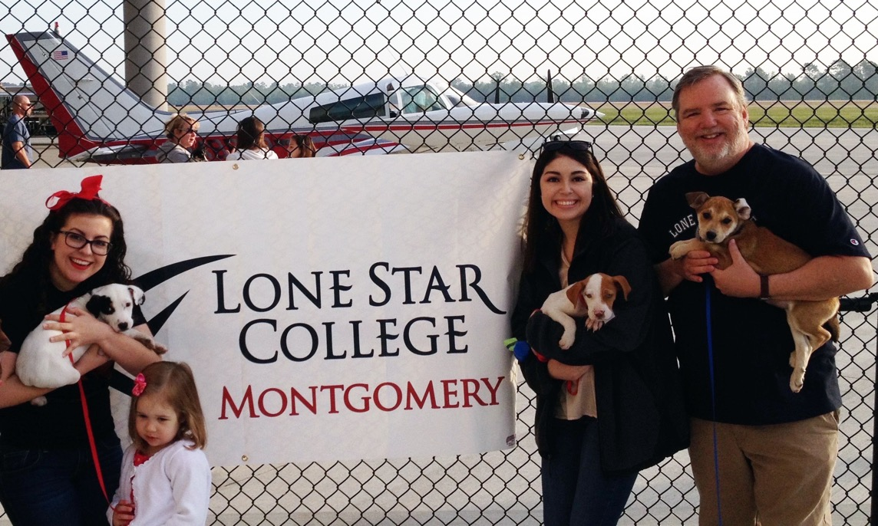
We have the best jobs in the world! A chance to make the world a better place.
—Kevin Sumrall, Lone Star College-Montgomery (Texas)

Slide 86
I teach, and thereby I empower. Above any charitable act one can perform, teaching is the most merciful, the most blessed thing a human can do for another. I give my students power through my teaching as electric as lightning bolts. From there, they go light up the world.
—Lashun R. Griffin, Lone Star College-North Harris (Texas)

Slide 87
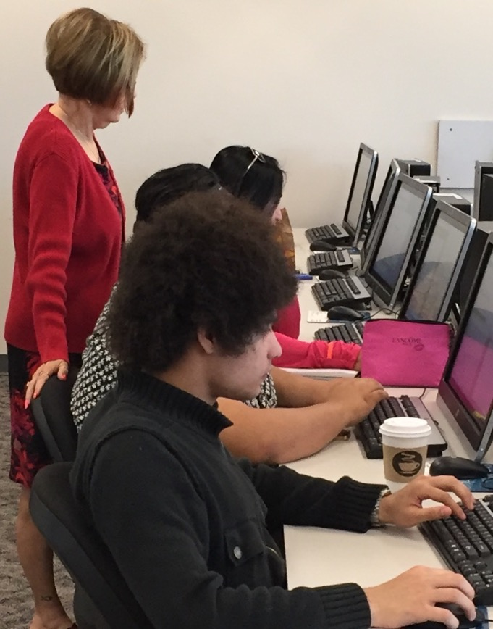
I believe that everyone can learn given enough time and the appropriate learning environment. I learn from my students as much as they learn from me, the “learning facilitator.” Every day is a joy when I see the smiling (or not smiling) faces of my students.
—Patricia Lyon, Lone Star College - Tomball (Texas)

Slide 88
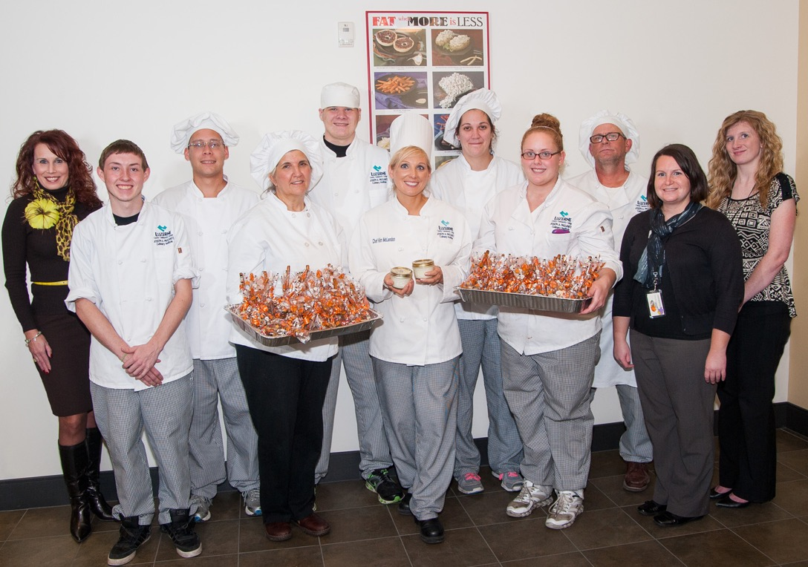
As quoted by Henry Ford, “Coming together is a beginning, keeping together is progress, working together is success.” The power of teamwork is a vital and critical aspect in providing the absolute best educational resources as we work to create lifelong learners.
—Rebecca Brominski, Luzerne County Community College (Pennsylvania)

Slide 89
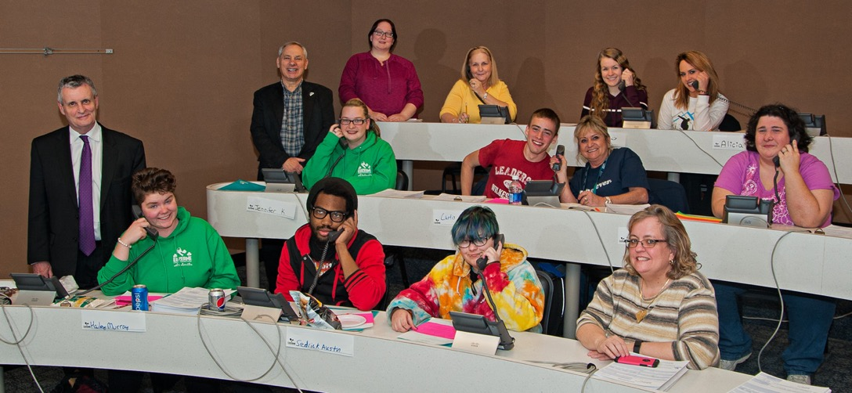
I enjoy working with students during our phonathon. They make the connection of giving back to their alma mater and improve their communication skills. Faculty offer credit to students who volunteer to support LCCC. Some students get very competitive and motivated by their success. It’s a win-win.
—Bonnie Lauer, Luzerne County Community College (Pennsylvania)

Slide 90
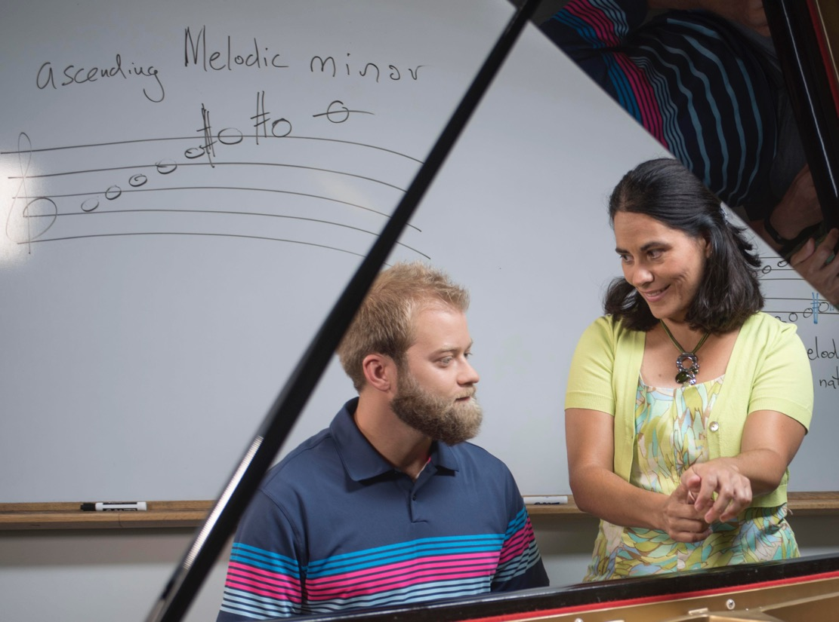
Teaching is mentoring, advising, understanding, challenging, and encouraging students, even years after their graduation. My mission is to help them contribute toward a better world and to reach their highest potential, showing them that with dedication, there is always a path to achieve it.
—Carolina Flores, Manchester Community College (Connecticut)

Slide 91
I am honored to receive such a wonderful award. Manchester Community College has brought out the best in me, as a student and as an employee. There's no place else that I would rather be.
—Brian Lombardo, Manchester Community College (Connecticut)

Slide 92
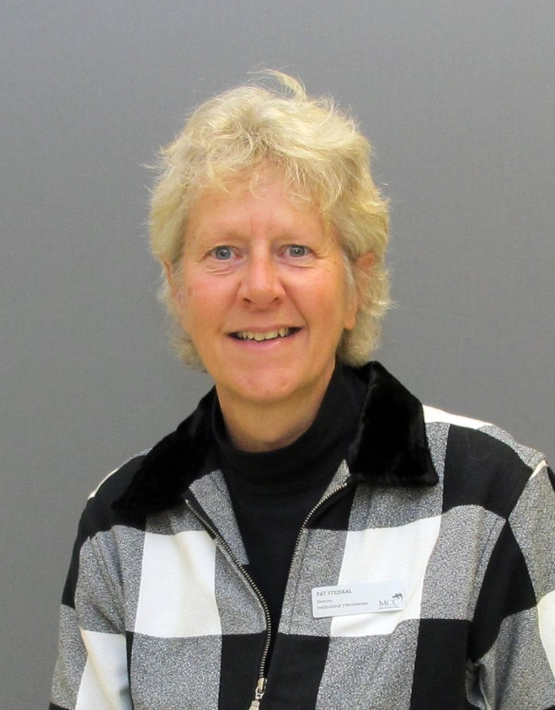
Being part of the great Professional Development Team at the college inspires and motivates me to try and bring out the best in people by helping, encouraging, and serving all of our employees from across the campus.
—Pat Stejskal, McHenry County College (Illinois)

Slide 93
I have a passion for history and lifelong learning. I inspire my students to develop their own passion. History is a never-ending debate. I encourage my students to devise their own interpretations and think critically, which is useful in any field. Use different learning styles, engage, and model for them.
—David White, McHenry County College (Illinois)

Slide 94
I am inspired to work in an environment that encourages growth, development, and selfless service. Through my work with students and co-workers, I am motivated to nurture others with love, patience, responsible action, compassionate response, and disciplined activity. It is my privilege to be a positive influencer.
—Herman Tucker, McLennan Community College (Texas)

Slide 95
“The environment where learning occurs is extremely important. When students feel comfortable sharing thoughts they become more comfortable absorbing information from others. This sets the stage for an atmosphere where positive, encouraging, and motivating learning situations occur. The art of teaching is the art of assisting discovery.” —Mark Van Doren
—Deb Holst, Metropolitan Community College (Nebraska)

Slide 96
I teach art. I teach drawing technique, composition, paint handling, observational skills, and creative problem solving. None of that is as important as what I really believe teaching is all about—for students to see the spirit and vitality in themselves.
—Rachel Mindrup, Metropolitan Community College (Nebraska)

Slide 97
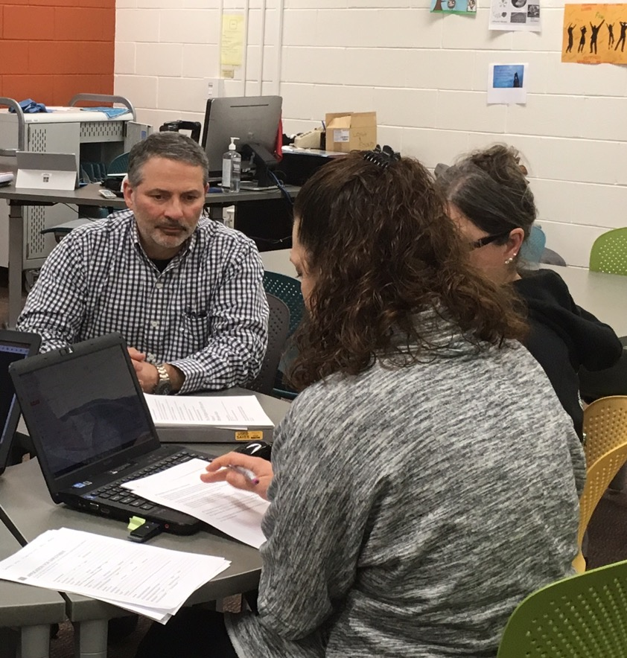
For centuries we've taught people to work by having them do work. Now we try to teach them to work by standing at the front of the room and talking about how to do work. In my classes, I try to ensure that students learn to work by working.
—Steven Nichols, Metropolitan Community College (Nebraska)

Slide 98
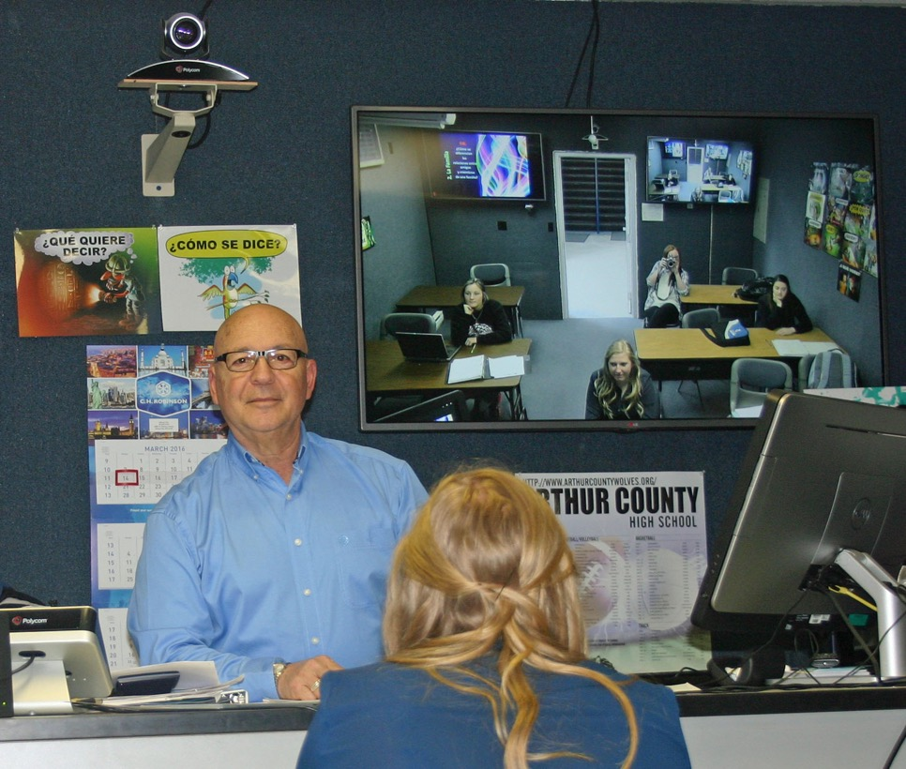
Teachers motivate students to achieve infinitely more. As a change agent in my students’ lives, I am never dissuaded by poor attitudes and downcast faces. Those are temporary. My goal is to show that effort equals performance, and that academic excellence will be a proud achievement remembered throughout students’ lifetimes.
—Jack Ramos-Needham, Mid-Plains Community College (Nebraska)

Slide 99
My inspiration is Middlesex Community College’s dedicated, intelligent, and generous science faculty. They have fueled my passion for conveying complex subject matter in a manageable way. My hope is that students will be fascinated by the content and committed to lifelong learning.
—Jean Cremins, Middlesex Community College (Massachusetts)

Slide 100
As a nurse educator, my goal is to foster students’ success by creating innovative and engaging learning opportunities. More importantly, I challenge myself to make complex concepts accessible and meaningful. The journey from student to nurse is a great one. I take pride in being part of the transformation.
—Cassandra DelCheccolo, Middlesex Community College (Massachusetts)

Slide 101
My inspiration is renewed every September as new students enter the college. Their ability to navigate the sometimes-winding path to a higher education is not always innate. I have the privilege of empowering students to achieve their goals. I love the work I do because their success is my success.
—Faithe MacElliott, Middlesex Community College (New Hampshire)

Slide 102
My primary job is teaching English, but my most important job is training students to be successful in life. I always tell my students, If you practice “good enough,” that is all you will ever be. If you practice excellence, you will be successful in all you do.
—Denise Marchionda, Middlesex Community College (Massachusetts)

Slide 103
Students need to learn more than just facts and figures; they must learn how to apply the information learned to a new situation and think critically about the world in which we live. I remind my students to think outside the box, focus concepts, and remember the big picture.
—Matthew Borcherding, Minnesota State Community and Technical College (Minnesota)

Slide 104
Comprehensive research at the college level allows our students to discover unknown topics facing our global community at home and around the world. Working with the K-to-College initiative, I introduced activities to the kindergartners that previewed the formal educational opportunities that await them in college.
—Deborah Newman, Montgomery College (Maryland)

Slide 105
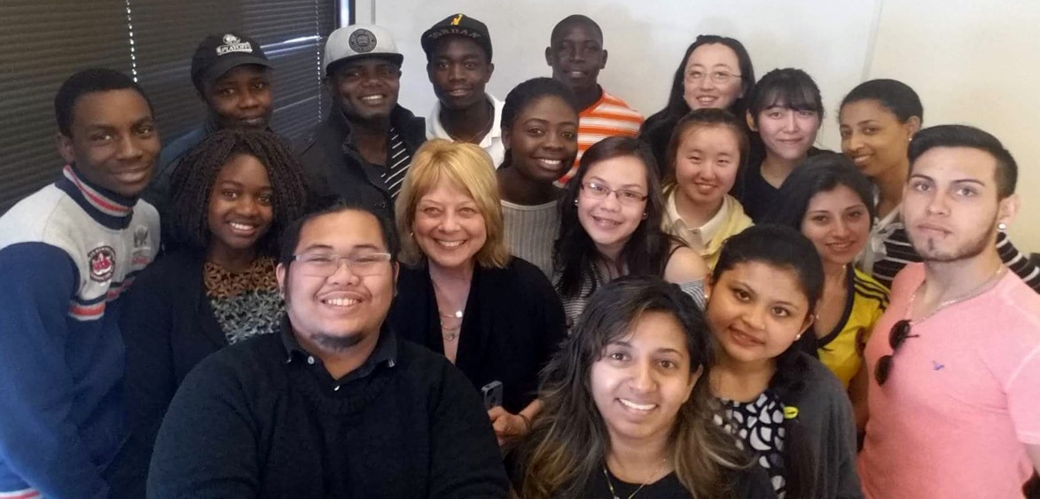
Are you a “Sage on the Stage” or a “Guide on the Side?” Sometimes my students have little or no prior knowledge for foundation skills, so initially I need to give direct instruction. Later, I can move to a more constructivist approach. Bottom line: I take the approach that works!
—Ann Sallie, Montgomery College (Maryland)

Slide 106
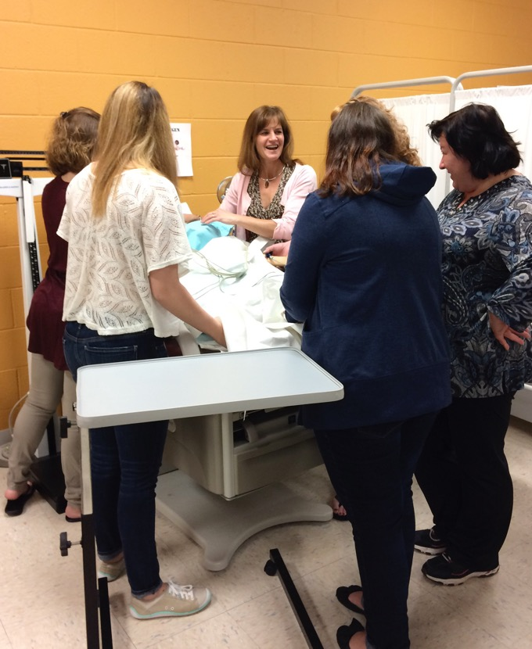
—Robin Cavallo, Montgomery County Community College (Pennsylvania)

Slide 107
I strive to lead by example, working as hard as my students. I give each student the freedom to learn in the style that best fits them. I interview each student to determine what methods make them successful. I then convey these to the less successful students.
—Kevin Fitch, Motlow College (Tennessee)

